Slide 1


Fabian Pedreros
Jan 2023

Slide 2

Outline
Executive Summary
Introduction
Methodology
Results
Conclusion
Appendix

Slide 3
Executive Summary
Summary of methodologies
Web scraping and API use to data collection.
Exploratory Data Analysis (EDA) to understand and visualize the collected data.
Supervised Machine Learning algorithms to classify the results of a landing (success or not)
Summary of all results
It is possible to create a Machine Learning model that helps to predict if a SpaceX landing is successful or not.

Slide 4
Introduction
Project background and context
SpaceX is a US aerospace manufacturing and space transportation services company, is at the forefront of the industry because its launch costs are the lowest in the market, in large part due to the fact that it reuses the first state. Therefore if we can determine if the first stage will land, we can determine the cost of a launch. For the project are taking in account the Falcon 9 rockets.
Problems you want to find answers
What attributes of a landing can be used to predict if is successful or not?
What is Machine Learning model that can predict with the major precision if a landing is successful or not?

Slide 5

Section 1

Slide 6
Methodology
Executive Summary
Data collection methodology:
The data collection of the Falcon 9 landings is done using two sources:
SpaceX API (https://api.spacexdata.com/v4/rockets/)
Public data from Wikipedia (https://en.wikipedia.org/w/index.php?title=List_of_Falcon_9_and_Falcon_Heavy_launches&oldid=1027686922)
Perform data wrangling
Summarized data analysis is performed to understand the distributions of landings by orbit and launch sites, as well as the creation of the dependent variable 'Class', which identifies whether a landing was successful (1) or not (0).

Slide 7
Methodology
Executive Summary
Perform exploratory data analysis (EDA) using visualization and SQL
Perform interactive visual analytics using Folium and Plotly Dash
Perform predictive analysis using classification models
Normalization and data encoding was need it due to the nature of the variables.
Training and test datasets have been created for the independent variables that explain whether a spacecraft lands or not.
Three different classification algorithms (SVM, Classification Trees and Logistic Regression) are trained.
Grid Search is used to establish which are the best hyper parameters that give the highest accuracy for each model.
The selection of the best model is done by selecting the highest accuracy..

Slide 8
Data Collection
The data sets were collected using two different sources and techniques:
API request. For SpaceX data launch using a service provided for the enterprise.
Web Scraping. To request public data available in the web, where we can find information about the rockets.

Slide 9
Data Collection – SpaceX API
It is executed a data extraction using the API public services for SpaceX. This data is requested initially in Json format and then transformed and filtered into a DataFrame.
Code: https://github.com/FabianPedreros/IBM-Data-Science-Capstone/blob/main/jupyter-labs-spacex-data-collection-api.ipynb
Request and parse the SpaceX launch data
Filter it to only include `Falcon 9` launches
Deal with Missing Values

Slide 10
Data Collection - Scraping
Web scrap Falcon 9 launch records is done using `BeautifulSoup`, extracting the Falcon 9 launch from the HTML Table and then convert it to a data frame.
Code:
https://github.com/FabianPedreros/IBM-Data-Science-Capstone/blob/main/jupyter-labs-webscraping.ipynb
Request the Falcon9 Launch Wiki page from Wikipedia
Extract all column/variable names from the HTML
Create a data frame by parsing the launch HTML tables

Slide 11
Data Wrangling
Describe how data were processed
You need to present your data wrangling process using key phrases and flowcharts
Add the GitHub URL of your completed data wrangling related notebooks, as an external reference and peer-review purpose

Slide 12
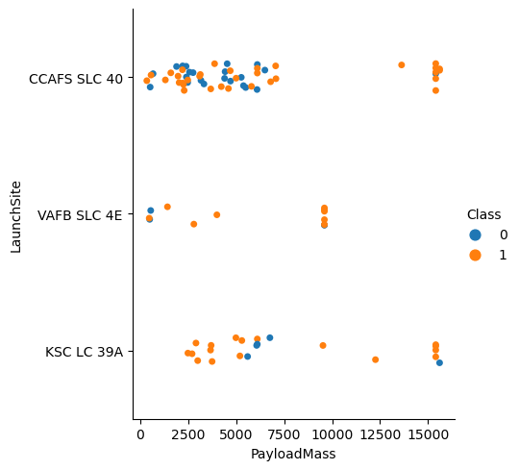
EDA with Data Visualization
In order to understand the data and find relevant attributes than can explain the landing success, is done a EDA to explore relationships via visualization as:
Payload mass vs flight number
Site number vs Launch site
Payload mass vs Launch site
Orbit success
Flight number vs Orbit Type
Orbit vs Flight number
Code:
https://github.com/FabianPedreros/IBM-Data-Science-Capstone/blob/main/jupyter-labs-eda-dataviz.ipynb
Launch site vs Payload mass success

Slide 13
EDA with SQL
The SQL queries that were performed to explore the data were:
Display the names of the unique launch sites in the space mission
Display 5 records where launch sites begin with the string 'CCA'
Display the total payload mass carried by boosters launched by NASA (CRS)
Display average payload mass carried by booster version F9 v1.1
List the date when the first successful landing outcome in ground pad was achieved.
List the names of the boosters which have success in drone ship and have payload mass greater than 4000 but less than 6000
List the total number of successful and failure mission outcomes
List the names of the booster_versions which have carried the maximum payload mass.
List the records which will display the month names, failure landing_outcomes in drone ship ,booster versions, launch_site for the months in year 2015.
Rank the count of successful landing_outcomes between the date 04-06-2010 and 20-03-2017 in descending order. Code: https://github.com/FabianPedreros/IBM-Data-Science-Capstone/blob/main/jupyter-labs-eda-sql-coursera_sqllite.ipynb

Slide 14
Build an Interactive Map with Folium
Object such as markers, and circles were added to a folium map in order to show graphically and geographically the sites and results from the rockets were launched. Lines were used to show and measure the distance between a point of interest and the launch sites.
This objects are relevant to gain information about the locations, and examine if a relation with the sites environment can conduct to a successful landing.
Code: https://github.com/FabianPedreros/IBM-Data-Science-Capstone/blob/main/lab_jupyter_launch_site_location.ipynb

Slide 15
Build a Dashboard with Plotly Dash
The plots and graphs added to the dashboard were:
Pie chart for the launches by site.
Scatterplot with Payload Mass vs Class.
With interactions like a list where you can select the launch to use in the pie chart and a slide for the Payload range to visualize in the scatterplot.
These graphs helps to understand how the success is distributed in the different locations, and how the payload range can be an attribute that explains the landing success.
Code: https://github.com/FabianPedreros/IBM-Data-Science-Capstone/blob/main/spacex_dash_app2.py

Slide 16
Predictive Analysis (Classification)
The process of creating a supervised classification model to provide which landing is satisfactory included separating the data into training and test subsets, normalizing and coding the values, as well as training three different models (SVC, Tree classification, logistic regression) and evaluating them using accuracy metric.
Code: https://github.com/FabianPedreros/IBM-Data-Science-Capstone/blob/main/SpaceX_Machine%20Learning%20Prediction_Part_5.ipynb
Normalization and encoding
Train and Test split
Model creation
Model fitting and hyper parameter tuning (GridSearch)
Model selection
Model evaluation

Slide 17
Results
Exploratory data analysis results:
As SpaceX launches more launches, the more successful they become.
The site with the highest success rate is the called KSC LC 39A with almost 77% success rate.
The VAFB SLC 4E site has a high success rate, however it is the site with the fewest launches of the three sites evaluated.
There are orbits with a high success rate such as SSO (100%) and VLEO (greater than 80%) which have also had more than five launches.
The orbit with the worst landing success rate is GTO, with 55%.The orbit together with PayloadMass seem to have a correlation with landing success.

Slide 18
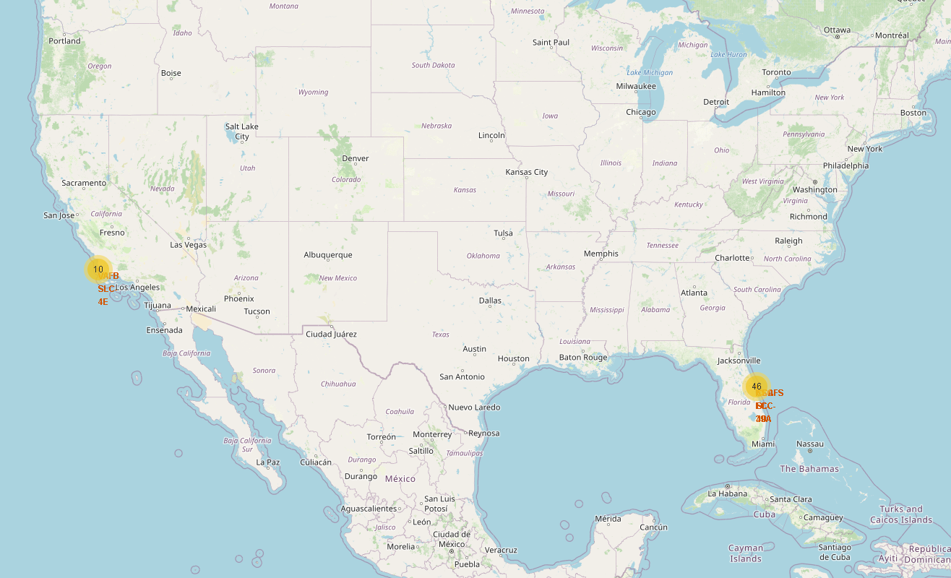
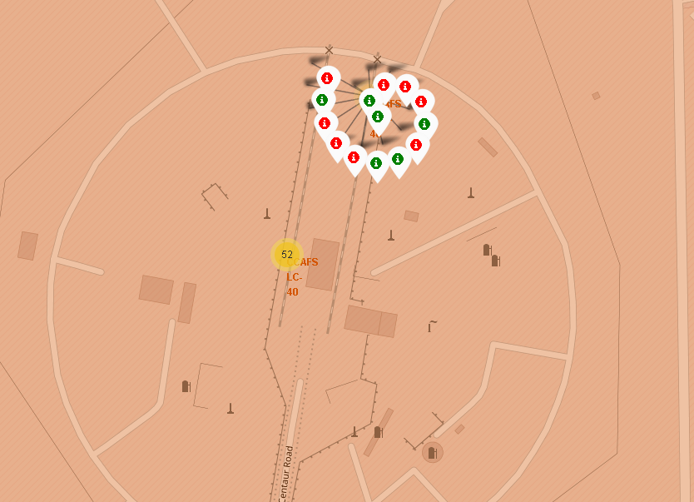
Results
Interactive analytics demo in screenshots

Slide 19
Results
Predictive analysis results
The best performing supervised classification machine learning algorithm in terms of accuracy was found to be the decision tree, with a training accuracy of 89% and test accuracy of 83%.
The best performing decision tree model was the hyper-parameter model equal to: 'criterion': 'gini', 'max_depth': 18, 'max_features': 'sqrt', 'min_samples_leaf': 1, 'min_samples_split': 10, 'splitter': 'best'.

Slide 20

Section 2

Slide 21
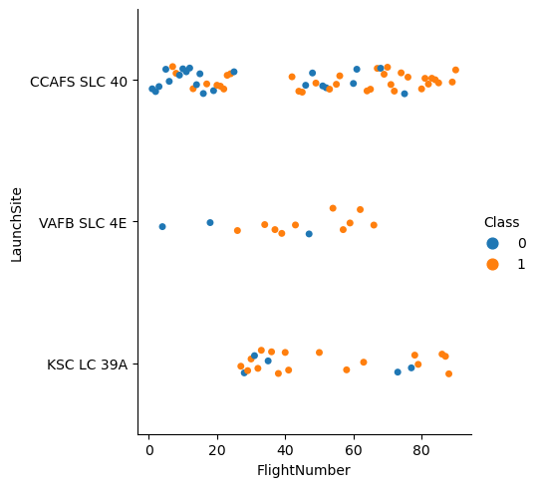
Flight Number vs. Launch Site
The launch site with the highest accuracy is KSC LC 39A.
The launch site with the worst performance is the CCAFS SLC 40.
Over the time the landing success has been improved.

Slide 22
Payload vs. Launch Site
This scatterplot show us how the first state rockets with a mass below the 7500 kg in the CCAFS site had a very low success. Meanwhile in the other two sites the flights with the same mass were successful.
The landings with greater mass of 7500 to were more successful.

Slide 23
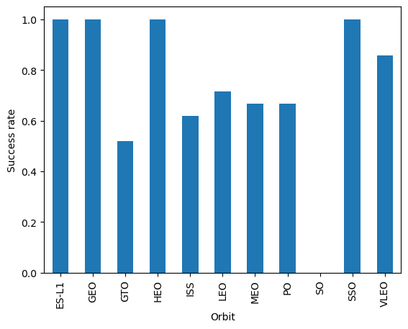
Success Rate vs. Orbit Type
The orbits with the highest successful rate were ES-L1, GEO, HEO and SSO with 100%
But should be considered the number of flights to that orbits.
VLEO seem to be a great accuracy and GTO the worst. Not taking into account the extreme points.

Slide 24
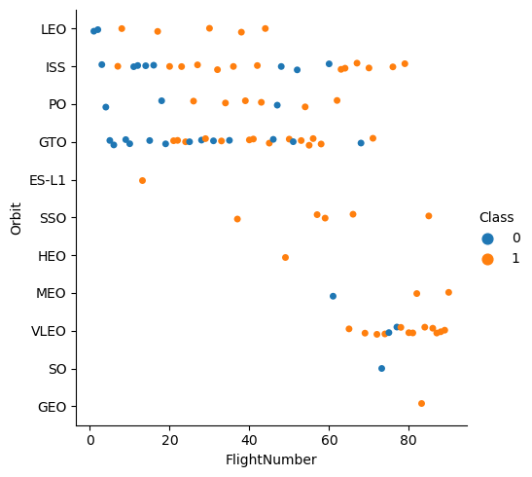
Flight Number vs. Orbit Type
The GEO, HEO, and ES orbits had a high success rate due to the few flights done to that orbits.
The most successful orbit is the SSO.
LEO had improved the success over the flights.

Slide 25
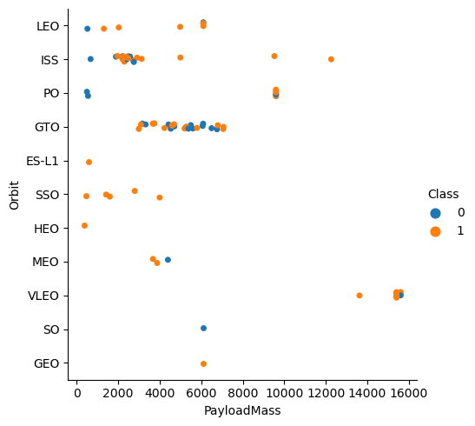
Payload vs. Orbit Type
The landings with a mass greater that 7500 had a greater success rate.
The SSO orbit has a great success rate.

Slide 26
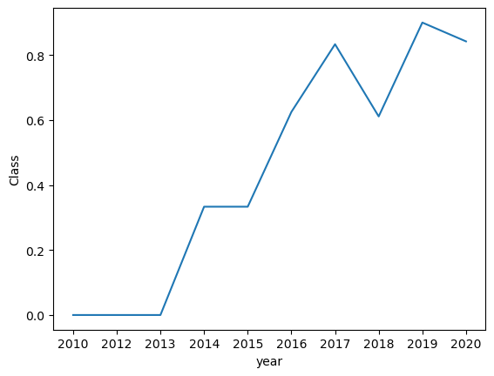
Launch Success Yearly Trend
In the scatterplot we can see how the launch success has increased over the years, with a drop in 2018.

Slide 27
All Launch Site Names
Query the unique launch sites in the space mission.
Launch_Site
CCAFS LC-40
VAFB SLC-4E
KSC LC-39A
CCAFS SLC-40

Slide 28
Launch Site Names Begin with 'CCA'
Query all the data from the table filtering the Launch sites that begin with ‘CCA’ and limiting the results to the first five rows
Date | Time (UTC) | Booster_Version | Launch_Site | Payload | PAYLOAD_MASS__KG_ | Orbit | Customer | Mission_Outcome | Landing _Outcome
04-06-2010 | 18:45:00 | F9 v1.0 B0003 | CCAFS LC-40 | Dragon Spacecraft Qualification Unit | 0 | LEO | SpaceX | Success | Failure (parachute)
08-12-2010 | 15:43:00 | F9 v1.0 B0004 | CCAFS LC-40 | Dragon demo flight C1, two CubeSats, barrel of Brouere cheese | 0 | LEO (ISS) | NASA (COTS) NRO | Success | Failure (parachute)
22-05-2012 | 07:44:00 | F9 v1.0 B0005 | CCAFS LC-40 | Dragon demo flight C2 | 525 | LEO (ISS) | NASA (COTS) | Success | No attempt
08-10-2012 | 00:35:00 | F9 v1.0 B0006 | CCAFS LC-40 | SpaceX CRS-1 | 500 | LEO (ISS) | NASA (CRS) | Success | No attempt
01-03-2013 | 15:10:00 | F9 v1.0 B0007 | CCAFS LC-40 | SpaceX CRS-2 | 677 | LEO (ISS) | NASA (CRS) | Success | No attempt

Slide 29
Total Payload Mass
Group the Payload mass data using a sum and filtering the customer to be the NASA.
Customer | SUM(PAYLOAD_MASS__KG_)
NASA (CRS) | 45596

Slide 30
Average Payload Mass by F9 v1.1
Group the payload mass by the Booster version, filtering the results by the booster version that contains F9 V1.1
Booster_Version | AVG(PAYLOAD_MASS__KG_)
F9 v1.1 B1003 | 500.0
F9 v1.1 B1010 | 2216.0
F9 v1.1 B1011 | 4428.0
F9 v1.1 B1012 | 2395.0
F9 v1.1 B1013 | 570.0
F9 v1.1 B1014 | 4159.0
F9 v1.1 B1015 | 1898.0
F9 v1.1 B1016 | 4707.0
F9 v1.1 B1017 | 553.0
F9 v1.1 B1018 | 1952.0

Slide 31
First Successful Ground Landing Date
Query the dates that were a ‘Success (ground pad)’ order ascending by the date and just taking the first row.
Date
01-05-2017

Slide 32
Successful Drone Ship Landing with Payload between 4000 and 6000
Query the booster version where the landing outcome is equal to ‘Success (drone ship)’ and the payload mass is between 4000 a 6000 kg.
Booster_Version
F9 FT B1022
F9 FT B1026
F9 FT B1021.2
F9 FT B1031.2

Slide 33
Total Number of Successful and Failure Mission Outcomes
Listing the possible landing outcomes
Landing _Outcome
Failure (parachute)
No attempt
Uncontrolled (ocean)
Controlled (ocean)
Failure (drone ship)
Precluded (drone ship)
Success (ground pad)
Success (drone ship)
Success
Failure
No attemp

Slide 34
Boosters Carried Maximum Payload
Booster_Version
F9 B5 B1048.4
F9 B5 B1049.4
F9 B5 B1051.3
F9 B5 B1056.4
F9 B5 B1048.5
F9 B5 B1051.4
F9 B5 B1049.5
F9 B5 B1060.2
F9 B5 B1058.3
F9 B5 B1051.6
F9 B5 B1060.3
F9 B5 B1049.7
Find the maximum payload mass and query the booster version that have that maximum payload mass.

Slide 35
2015 Launch Records
Select the landing month, the landing outcome, booster version and launch site where the landing outcome are equal to ‘Failure (drone ship)’ and the year is 2015.
month | Landing _Outcome | Booster_Version | Launch_Site
01 | Failure (drone ship) | F9 v1.1 B1012 | CCAFS LC-40
04 | Failure (drone ship) | F9 v1.1 B1015 | CCAFS LC-40

Slide 36
Rank Landing Outcomes Between 2010-06-04 and 2017-03-20
Showing the count of rows where the Landing outcome were a success and the date was between 4-06-2010 and 20-03-2017, ordered in descending order.
Landing _Outcome | COUNT
Success | 20
Success (drone ship) | 8
Success (ground pad) | 6

Slide 37

Section 3

Slide 38
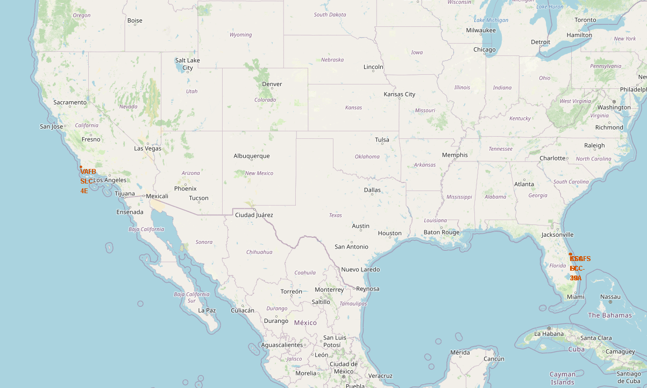
All launch sites
The map shows where Falcon 9 launches have taken place. There are three different launch places but two global cluster, one in the Florida and the other near Los Angeles. This are near the ocean.

Slide 39
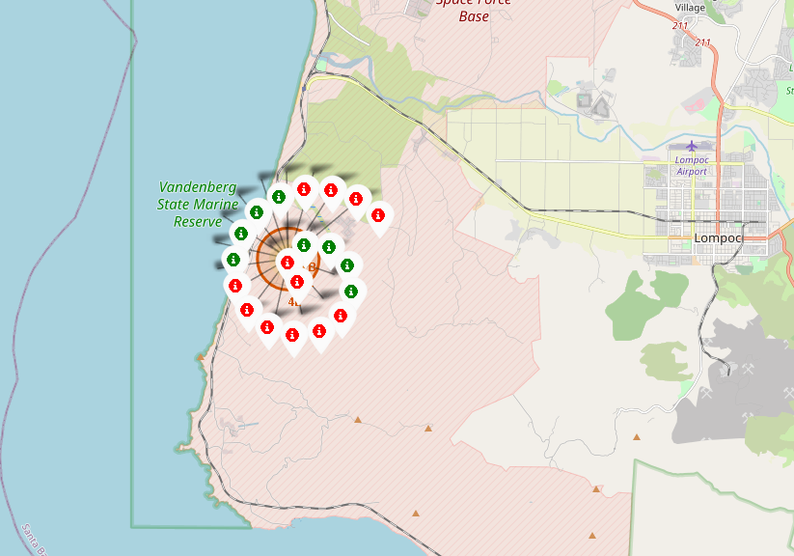
Launch outcomes
In the map we can see in each location the distribution of results, in red the Failed ones and in green the Successful ones.

Slide 40
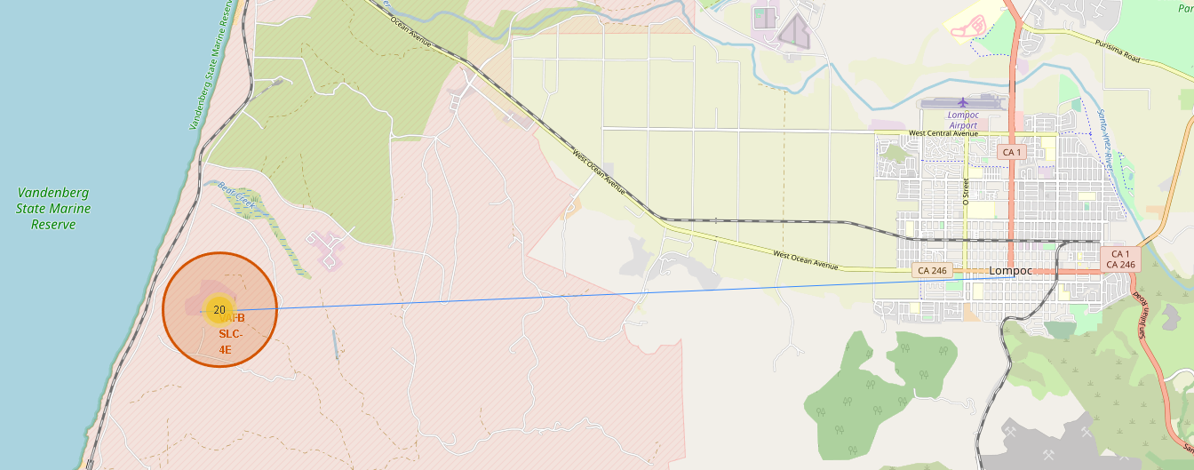
<Folium Map Screenshot 3>
The launch sites are far away from cities where the failed landings can be dangerous.

Slide 41

Section 4

Slide 42
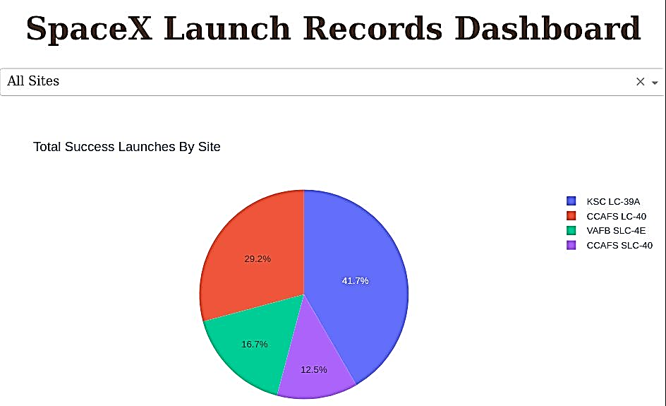
Success rate for all sites
In the pie chart we can see how the major part of landing successes are from KSC LC-40

Slide 43
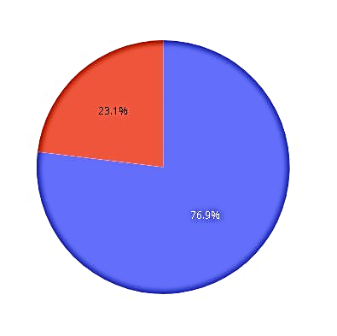
Site highest success ratio
In the pie char we can see how the site launch with the highest success ratio is the KSC LC-39A with almost 70% of success.

Slide 44
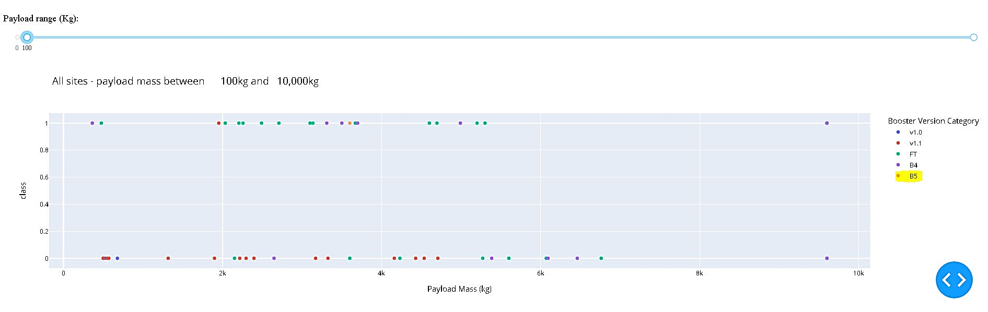
<Dashboard Screenshot 3>
Here we can see the flights class for every booster version and the relation with the payload mass, the booster version with the highest success rate is the B5.

Slide 45

Section 5

Slide 46
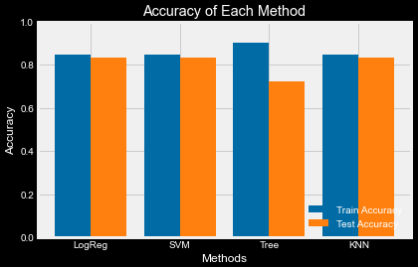
Classification Accuracy
In the bar chart we can see that the train accuracy is the highest for the tree model but the best test accuracy is for equal for lineal the models.

Slide 47
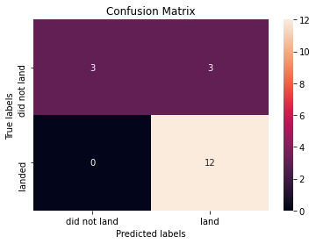
Confusion Matrix
The lineal models had the same precision, with some error for the predicted landing that in the reality did not land. In this cases we had false positives.

Slide 48
Conclusions
The site launch seems to have a correlation with a successful landing, in this case the SC LC-39A site has the highest success rate.
The payload mass seems to have a positive correlation with a successful landing, over the 7500 kg the success rate is high.
It is possible to predict the success or not of a landing using a supervised machine leaning model, SVC, Logistic Regression and KNN had the same precision in the test data.

Slide 49
Appendix
All the project with the different assets are in the GitHub repository:
https://github.com/FabianPedreros/IBM-Data-Science-Capstone

Slide 50


